Slide 1
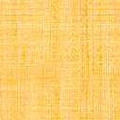

Multi-Resolution Hierarchical Clustering by
Vector Quantization
Paper ID : 1 4 6
Mainak Pal , Preeti Mukherjee and Amit Konar
Artificial Intelligence Laboratory
Jadavpur University
International Conference on Cybernetics, Cognition & Machine Learning Applications (16th-17th August), Goa, India

Slide 2

What is Clustering ?
Cluster : a collection of data objects
Similar to one another within the same cluster
Dissimilar to the objects in other clusters
Clustering
Grouping a set of data objects into clusters based on certain measure of similarity.
Clustering is unsupervised classification : No predefined classes
Typical applications
As a stand-alone tool to get insight into data distribution
As a preprocessing step for other algorithms
International Conference on Cybernetics, Cognition & Machine Learning Applications (16th-17th August), Goa, India

Slide 3
What Is Good Clustering ?
A good clustering method will produce high quality clusters with
high intra-class similarity
low inter-class similarity
The quality of a clustering result depends on both the similarity measure used by the method and its implementation.
The quality of a clustering method is also measured by its ability to discover some or all of the hidden patterns.
International Conference on Cybernetics, Cognition & Machine Learning Applications (16th-17th August), Goa, India

Slide 4
Problems associated with state-of-the-art clustering
In existing clustering algorithms, larger attributes have more contribution in the distance measure( between the presumed cluster centroid and datapoints) in comparison to the attributes of small values. Thus, attributes of smaller values even if differ by larger magnitude are not encountered in the clustering algorithms - causing false clustering.
Unfortunately, the existing clustering algorithms compare the datapoint generally by a distance measure between the cluster centroids and data-points to check the possible existence of data-points within a cluster, resulting in high computational complexity.
International Conference on Cybernetics, Cognition & Machine Learning Applications (16th-17th August), Goa, India

Slide 5
How can we improve?
International Conference on Cybernetics, Cognition & Machine Learning Applications (16th-17th August), Goa, India

Slide 6
Quantization is an option, but why quantization, what is Quantization?
Quantization refers to truncation or round off of an Analog signal to represent it in discrete levels of fixed amplitudes.
Quantization offers the freedom to examine the possible inclusion of individual attributes of a data-point within the bounds of the respective attributes of the cluster centroids.
International Conference on Cybernetics, Cognition & Machine Learning Applications (16th-17th August), Goa, India

Slide 7
How have we implemented this idea ?
The boundaries of attributes of the data-points in a cluster are selected by a fraction (such as α) of the dynamic range of the respective attributes of all the data-points, where α is left to the user to cluster data at desired resolutions. The choice of increasing α offers the freedom of multiresolutional hierarchical data-clustering where the lower value of α selects high density clusters (at higher level of the hierarchy) and the larger value of α returns clusters of relatively low data density (at the lower level of hierarchy).
International Conference on Cybernetics, Cognition & Machine Learning Applications (16th-17th August), Goa, India

Slide 8
Searching
Vector Quantization
Clustering
Merging
Sorting
International Conference on Cybernetics, Cognition & Machine Learning Applications (16th-17th August), Goa, India

Slide 9
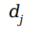

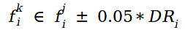
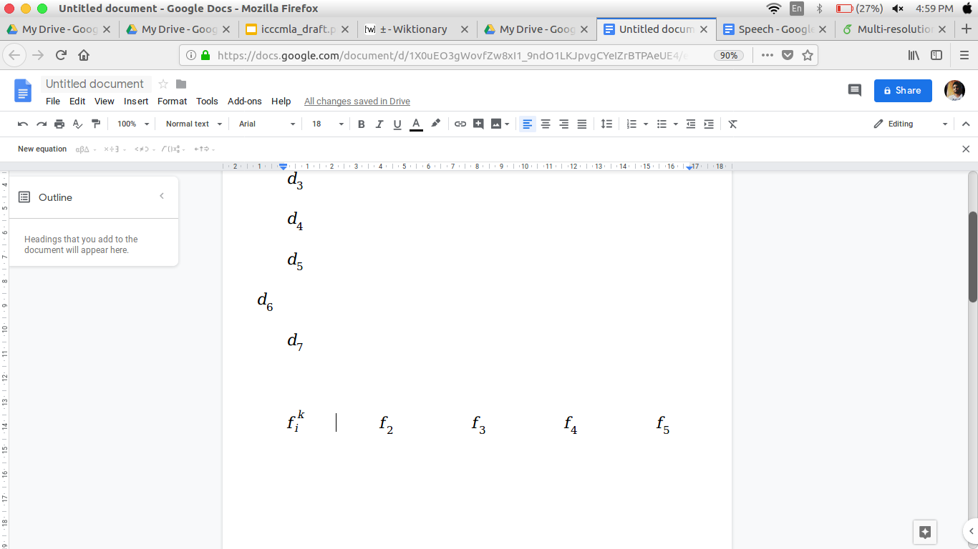
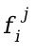
Searching
Pivot a point
For a given point if
Then tags .
If for all i, tags ,
Then falls in the cluster of
International Conference on Cybernetics, Cognition & Machine Learning Applications (16th-17th August), Goa, India

Slide 10
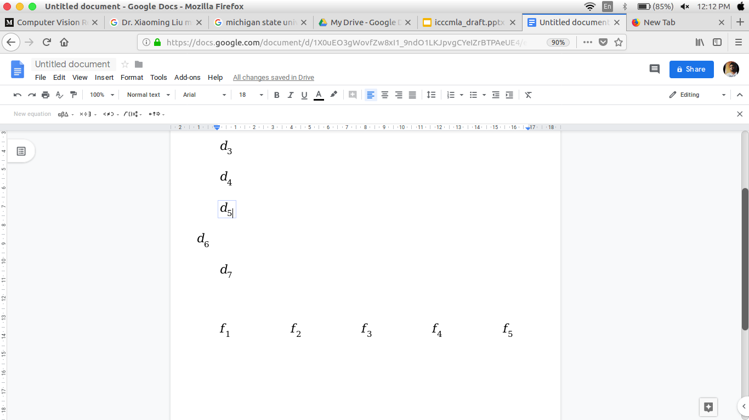
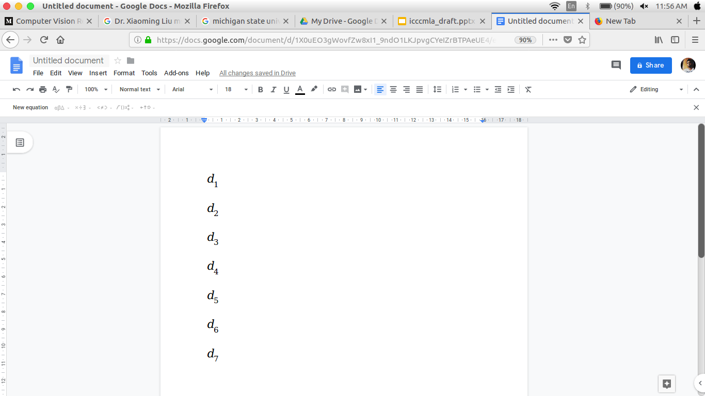
Illustrating the principles used in the Algorithm
Features
5 | 8 . 5 | 3 | 6 . 2 | 12
6 . 2 | 5 | 5 . 2 | 8 | 9
4 . 8 | 8 . 2 | 3 . 9 | 6 . 2 | 11 . 5
5 . 1 | 8 . 4 | 3 . 2 | 6 . 4 | 12 . 2
3 | 13 | 6 | 4 | 10 . 8
4 . 9 | 8 . 7 | 2 . 9 | 6 . 1 | 11 . 9
7 | 10 . 2 | 0 | 4 . 8 | 15
Data Points
Dynamic range
[ 3 - 7 ] | [ 5 - 13 ] | [ 0 - 6 ] | [ 4 - 8 ] | [ 9.2 - 15.2 ]
Allowable
radius
(7-3)*5% = 0.2 | (13-5)*5%=0.4 | (6-0)*5% = 0.3 | (8-4)*5%=0.2 | (15-9)*5%=0.3
Allowable
range
5 ± 0.2 | 8.5 ± 0.4 | 3 ± 0.3 | 6.2 ± 0.2 | 12 ± 0.3
International Conference on Cybernetics, Cognition & Machine Learning Applications (16th-17th August), Goa, India

Slide 11
Sorting
Sort the clusters based on their cardinality in descending order. That is based on the number of datapoints in a cluster.
Merging
Check the extent of overlapping between two consecutive sorted clusters.
If the similarity is greater than 85% (say), merge those clusters.
International Conference on Cybernetics, Cognition & Machine Learning Applications (16th-17th August), Goa, India

Slide 12
How it is different ?
Each data-point is given the freedom to be a trial cluster centroid. However, a few of these data-points, whose (quantized) bounds of attributes include respective attributes of a large number of data-points, concurrently, are selected as the final cluster centroids. Because of the quantized bounds of attributes, two selected cluster centroids always have significant spacing in n-dimensional hyperspace, where n denotes the dimension of the data-point.
International Conference on Cybernetics, Cognition & Machine Learning Applications (16th-17th August), Goa, India

Slide 13
Merits
The proposed algorithm thus facilitates automatic clustering with minimum risk of having false data-points in the clusters. The merit of the proposed algorithm is two fold. First, with the help of quantization of attributes of data-points, it eliminates the chance of false clustering (unexpected data-points) in a given cluster. Second, data-points of different density are clustered at different levels of the hierarchy, thereby providing significant information of data-points within a cluster, obtained at different resolutions.
International Conference on Cybernetics, Cognition & Machine Learning Applications (16th-17th August), Goa, India

Slide 14
Multi-resolution Clustering
The control in resolution is performed by suitable values of parameter α
The α -value is initialized at 0.2 arbitrarily, and the data-points with high data density are clustered.
After the high resolution data points are clustered, the clustering algorithm is re-invoked again for the second pass with increased value of α = α + 0.1.
The algorithm of multi-resolution terminates, when the number non-clustered data points goes below a user defined threshold.
The resulting clusters obtained for the smallest (possibilities) value of α have highest resolution. The proposed multi-resolution algorithm is called hierarchical as at different levels of the hierarchy the data-points are clustered at different resolution.
International Conference on Cybernetics, Cognition & Machine Learning Applications (16th-17th August), Goa, India

Slide 15
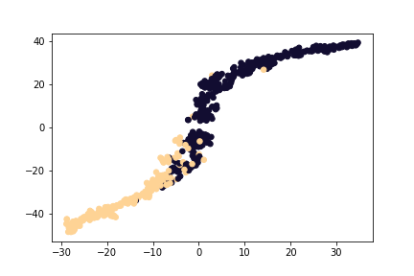
Experiment and Results
The prepared Vector-Quantization (VQ) based algorithm has been tested on 32 -dimensional breast cancer dataset for a two class classification problem: malignant and benign. It was noted that that for α = 0.26, proposed VQ clustering out-performs the well known k-means clustering algorithm with respect to Jaccard coefficient. Below is the T-SNE Plot of that incident.
Ground Truth
International Conference on Cybernetics, Cognition & Machine Learning Applications (16th-17th August), Goa, India

Slide 16
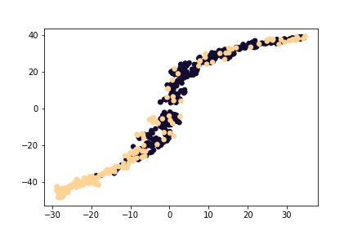
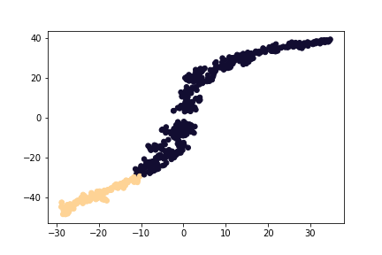
KMeans
VQ Clustering
International Conference on Cybernetics, Cognition & Machine Learning Applications (16th-17th August), Goa, India

Slide 17
Usage
Our proposed algorithm is found most effective on higher dimensional dataset like gene micro-array, RNA sequence etc.
Multi resolutional clustering gives us the freedom of clustering at different resolution. The high resolution clusters in certain applications, say image-processing, identify objects of interest, whereas the low density clusters offer the interrelation among objects in the image.
International Conference on Cybernetics, Cognition & Machine Learning Applications (16th-17th August), Goa, India

Slide 18
Thank You!
International Conference on Cybernetics, Cognition & Machine Learning Applications (16th-17th August), Goa, India

